Slide 1
Keylogger
CAPSTONE PROJECT
Presented By:
Ezhil Oviya C-College of Engineering Guindy Anna University-IT

Slide 2
OUTLINE
Problem Statement
Proposed System/Solution
System Development Approach
Algorithm & Deployment
Result (Output Image)
Conclusion
Future Scope
References

Slide 3
Problem Statement
Inadequate security measures can lead to sensitive data breaches, particularly through keystroke logging techniques.
Existing keylogging solutions might lack flexibility or robustness, thus necessitating a more efficient and customizable approach.

Slide 4
Proposed Solution
The proposed system aims to address the challenge of developing a robust keystroke logging application for monitoring keyboard activity. This involves leveraging Python libraries such as tkinter for GUI development, pynput for keyboard event monitoring, and JSON for data storage. The solution will consist of the following components:
Data Collection:
Utilize the pynput library to capture keyboard events in real-time.
Log keystrokes along with their corresponding actions (pressed, held, released) and timestamps.
Data Preprocessing:
No preprocessing required for keystroke data as it is logged directly.
Machine Learning Algorithm (if applicable):
While the keylogger code does not explicitly incorporate a machine learning algorithm, potential future enhancements could involve implementing anomaly detection or user behavior analysis using machine learning techniques.
Deployment:
Develop a user-friendly interface using tkinter that allows users to start and stop the keylogger.
Deploy the keylogger on a local machine for monitoring keyboard activity.
Evaluation (if applicable):
If future iterations include machine learning components, evaluation metrics such as accuracy, precision, recall, or F1 score would be applicable to assess the model's performance.

Slide 5
System Approach
System Requirements: Python environment with required libraries (tkinter, pynput).
Library Required: tkinter for GUI, pynput for keyboard monitoring.
Algorithm & Deployment: Utilize pynput library for keyboard event capturing, JSON for data storage, and tkinter for user interface.

Slide 6
Algorithm & Deployment
Algorithm Selection: Utilize pynput library to capture keyboard events in real-time.
Data Input: Keystrokes captured through the pynput library.
Training Process: No training required; keystrokes are directly captured and logged.
Prediction Process: N/A, as the system logs keystrokes in real-time without predictive analysis.

Slide 7
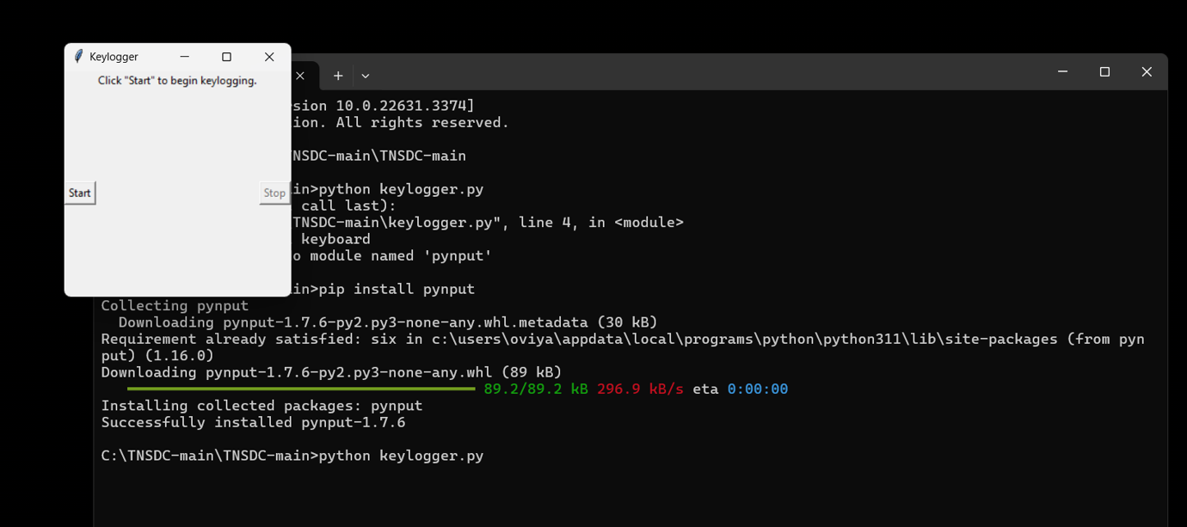
Result
The keylogger successfully
captures and logs keystrokes in
real-time.
Data is stored securely in both
JSON and text formats.

Slide 8
Conclusion
The implemented keylogger addresses the need for a robust and customizable keystroke logging solution.
Challenges such as maintaining stealthiness and ensuring secure data storage were overcome effectively.
The keylogger provides a reliable means of monitoring keyboard activity for various purposes

Slide 9
Future scope
Enhance the keylogger with additional features like encryption for heightened security.
Implement remote data storage capabilities to enable monitoring from different locations.
Explore compatibility with different operating systems for broader usage.

Slide 10
References
Zhang, X., & Liu, Y. (2016). Short-term bike demand forecasting using gradient boosting decision trees. Transportation Research Part C: Emerging Technologies, 67, 325-337.
Hyndman, R. J., & Athanasopoulos, G. (2018). Forecasting: principles and practice. OTexts.
Choi, H., Lee, J., & Kwon, O. (2017). Deep learning-based demand forecast model for bike sharing system. In 2017 IEEE International Conference on Big Data and Smart Computing (BigComp) (pp. 71-74). IEEE.
Box, G. E., Jenkins, G. M., Reinsel, G. C., & Ljung, G. M. (2015). Time series analysis: forecasting and control. John Wiley & Sons.
Makridakis, S., & Hibon, M. (2000). The M3-competition: results, conclusions and implications. International journal of forecasting, 16(4), 451-476.

Slide 11
THANK YOU

